Slide 1
Python Project
Group Members: Wei Jun , Jie Hong , De Xiang

Slide 2
Introduction
We are working under Best Cyber Pte Ltd.
The project is to create an application to perform penetration testing reconnaissance and mapping on their website to determine vulnerability for ABWEB Pte Ltd.

Slide 3
What is VCS?
A Version Control System is a system that records changes to a file or set of files over time so that you can recall specific versions later.
Using VCS, we can easily recover back selected files back to a previous state if we do it wrongly or lose it.

Slide 4
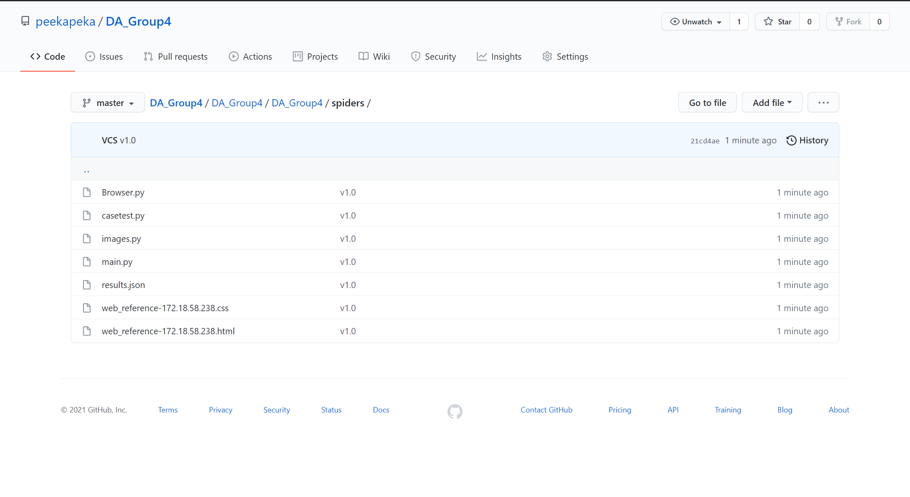
VCS(GITHUB)

Slide 5
Reconnaissance
Reconnaissance is the practice of covertly discovering and collecting information about a system. This method is often used in ethical hacking or penetration testing.
It consists of information of us getting an “OK” return status from our “get” request, website header and header user-agent. ​

Slide 6
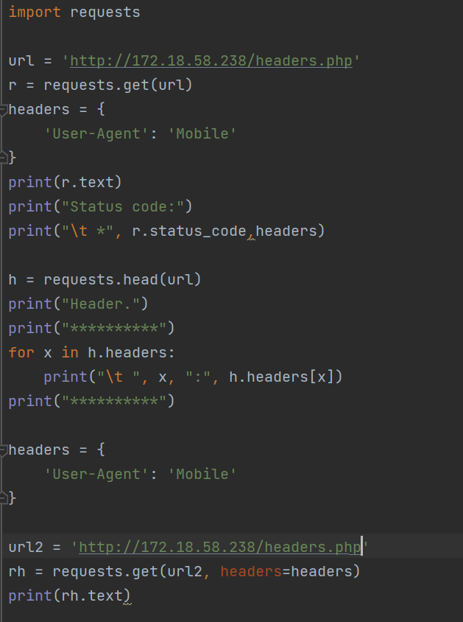
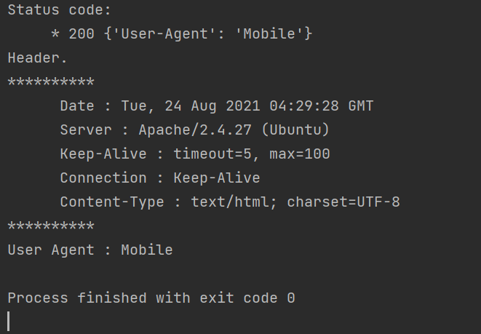
Reconnaissance Procedure
The first line shows status code: 200 which means “OK”
The User-Agent has been changed to show “Mobile”

Slide 7
Web Crawler
A web crawler bot is like someone who goes through all the books in a disorganized library and puts together a card catalog so that anyone who visits the library can quickly and easily find the information they need. ​

Slide 8
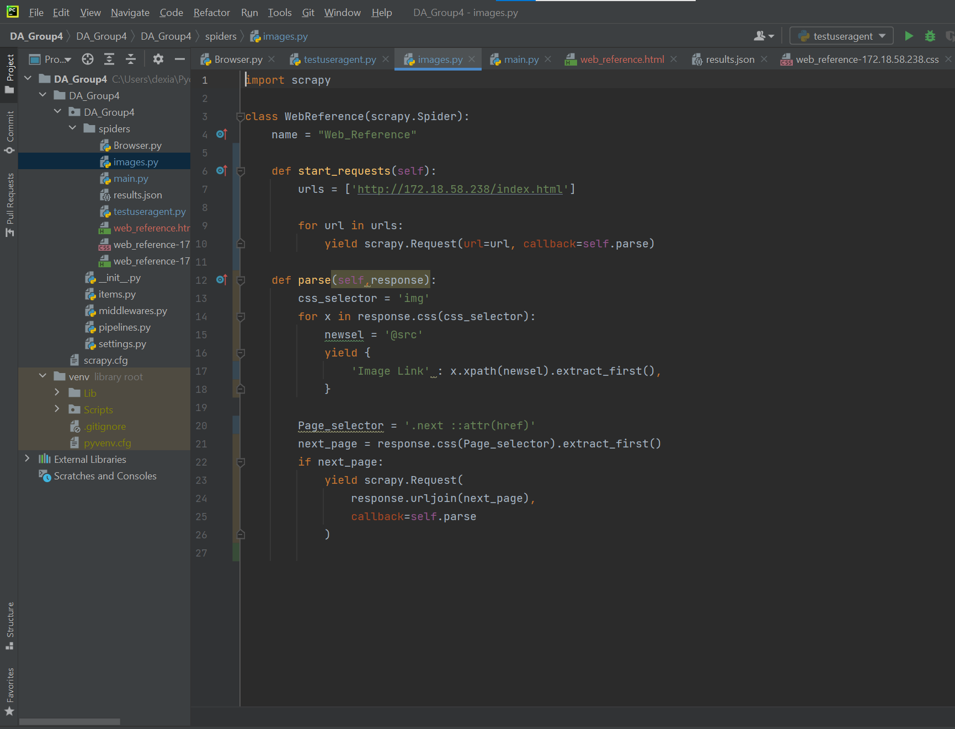
We crawl the website from http://172.18.58.238/index.html
Web Crawling

Slide 9
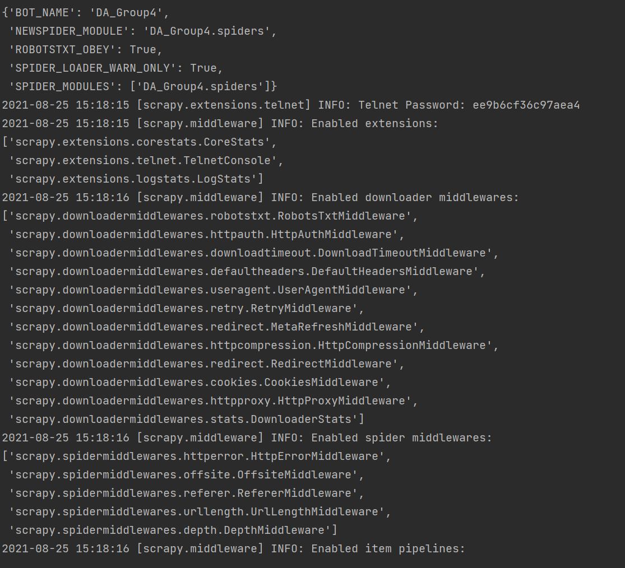
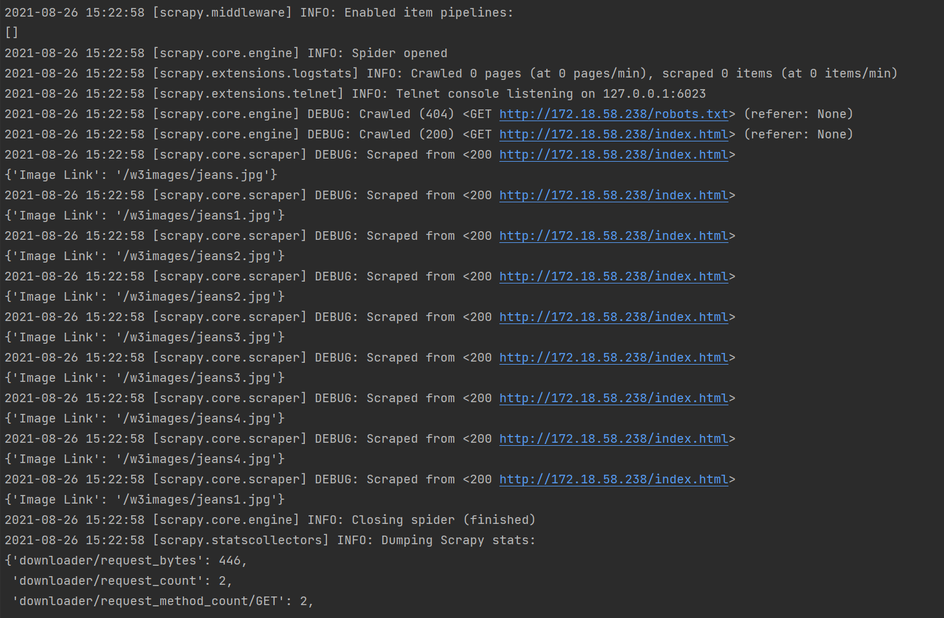
Result of Web Crawling

Slide 10
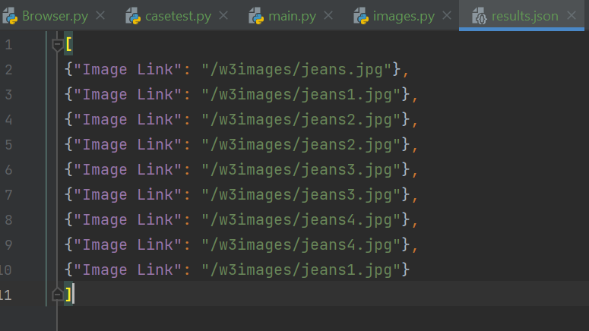
Image link
We got the image link output after running scrappy runspider in the terminal

Slide 11
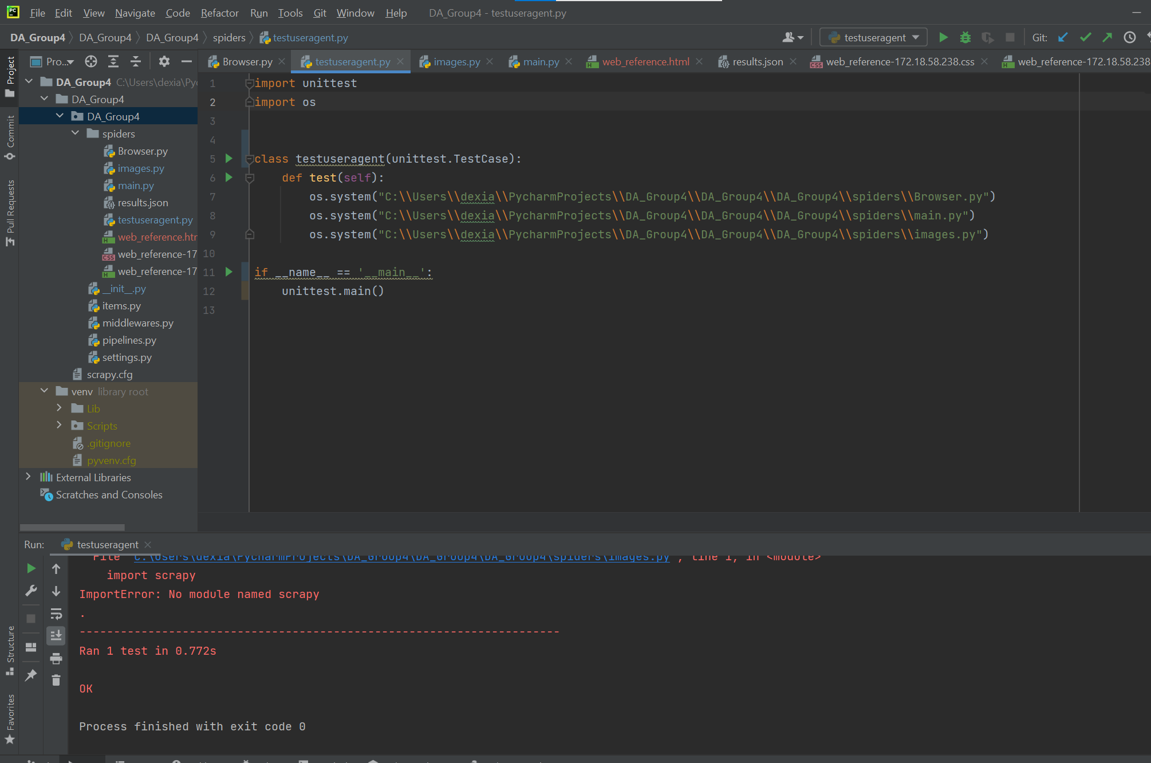
Unit Testing
Code for Unit Testing
Result of the unit testing

Slide 12


